Slide 1


CAPSTONE PROJECT
PART A
Manipulated Reality
Presented By
Maxim Lebedisnky 318171485 Dmytri Kislitsyn 323349738

Slide 2


Table of Contents
Introduction To Deepfakes……3
Possible Threats…………………….4
Our Solution…………………………….5
Development Process…………..6
Used Tools……………………………..7
Constraints & Challenges……..8
Result & Expectation……………..9
Model Architecture……………….10
Use Case………………………………..12
Activity Diagram……………………13
User Interface………………………..14
Testing…………………………………..17
Q&A……………………………………….18

Slide 3
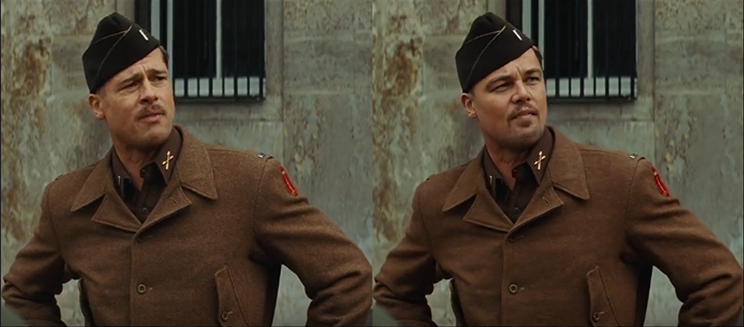
Deepfakes
Introduction
Two Categories of Deepfakes: video & audio.
Face swap, most popular used video deepfake application.
Generating a sound a like voice of a person.
Powered by AI and machine learning techniques, like autoencoders and generative adversarial networks (GANs).

Slide 4

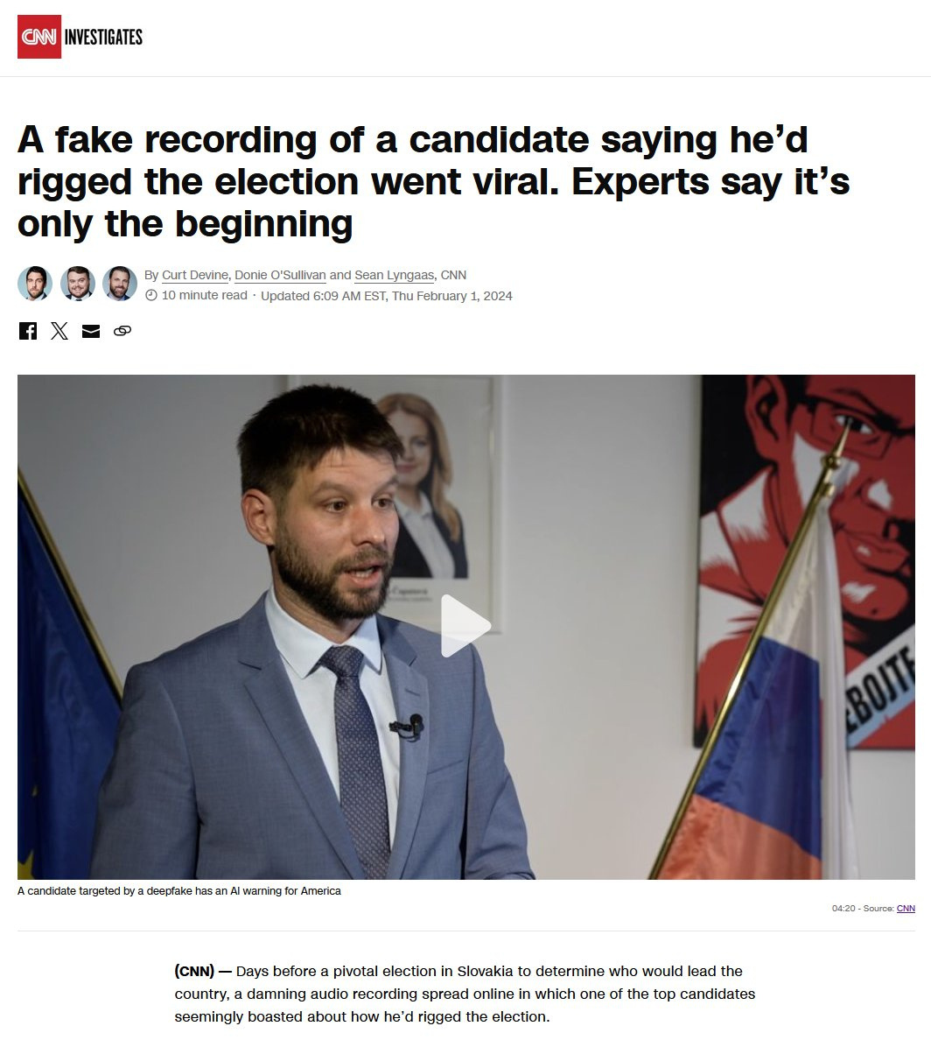
Deepfakes
New Threat to Reality
Propaganda films
Deepfakes are hyper-realistic and easy to create
Overwhelm our ability to determine real from fake.
Potential for manipulated elections, social unrest, and economic harm.
Easy accesses to deepfake models.

Slide 5
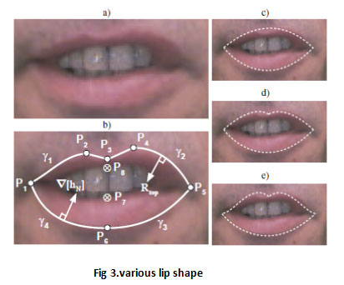
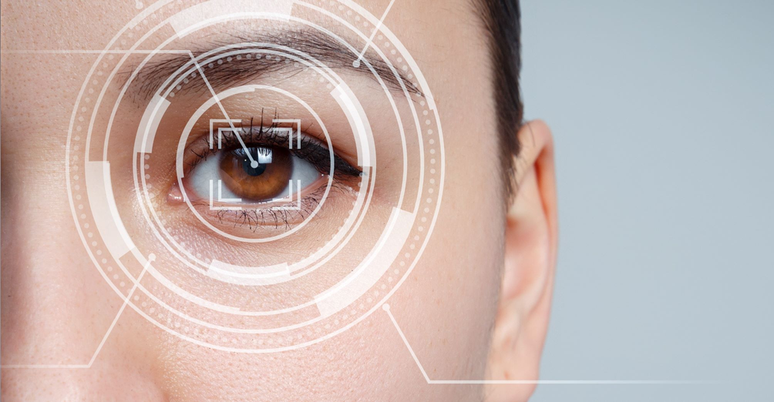
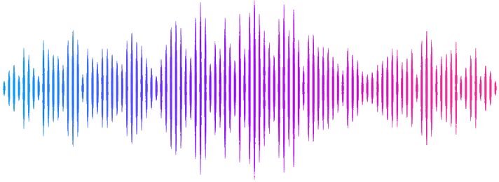
Combating Deepfakes
with Multimodal Analysis
Three Machine Learning Models
Analyzes mouth movements for inconsistencies.
Analyzes eye movements for inconsistencies.
Analyzes audio components for unusual speech features.
Combines visual and audio analysis for a more comprehensive assessment.

Slide 6
Deepfake Detector
The Process
Data Collection & Preparation
Setting up a massive dataset
Preprocessing
Video
Face detection to locate faces in videos
Further focus on the eyes and the mouth
Audio
Detect human speech
Discrete Fourier transform
Feature extraction
Training
Models will be trained on the prepared dataset
Through an iterative process, the models will be refined to achieve optimal accuracy.

Slide 7

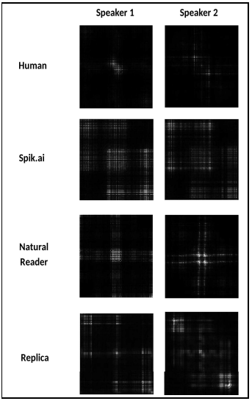
Deepfake Detector
The Tools
Video
Pillow: opening, manipulating images
Pandas and Numpy: Data structures, matrices,
math functions
OpenCV: Computer vision functions
Audio
Librosa: MFCC feature extraction.
Soundfile: Stereo to mono.
Numpy: Matrix and vector transformation.
Scipy: Fast Fourier Transform.
Model training
Keras: Customizing machine learning models.

Slide 8

Constraints & Challenges
Data Storage
Hundreds of GBs needed for video/audio data.
Limited Computation Capabilities
Large datasets and training on home computers.
Data Bias
Models can inherit biases from training data. FaceForensics++, Celeb-DF, DFDC for videos. WaveFake, In-The-Wild, Deep-Voice for audio.

Slide 9

Results & Expectations
Accuracy and Overtraining
Analyze results & fix accordingly
Minimum 80% accuracy
Ease of use
Simple user interface
Well written code (both training and implementation)

Slide 10
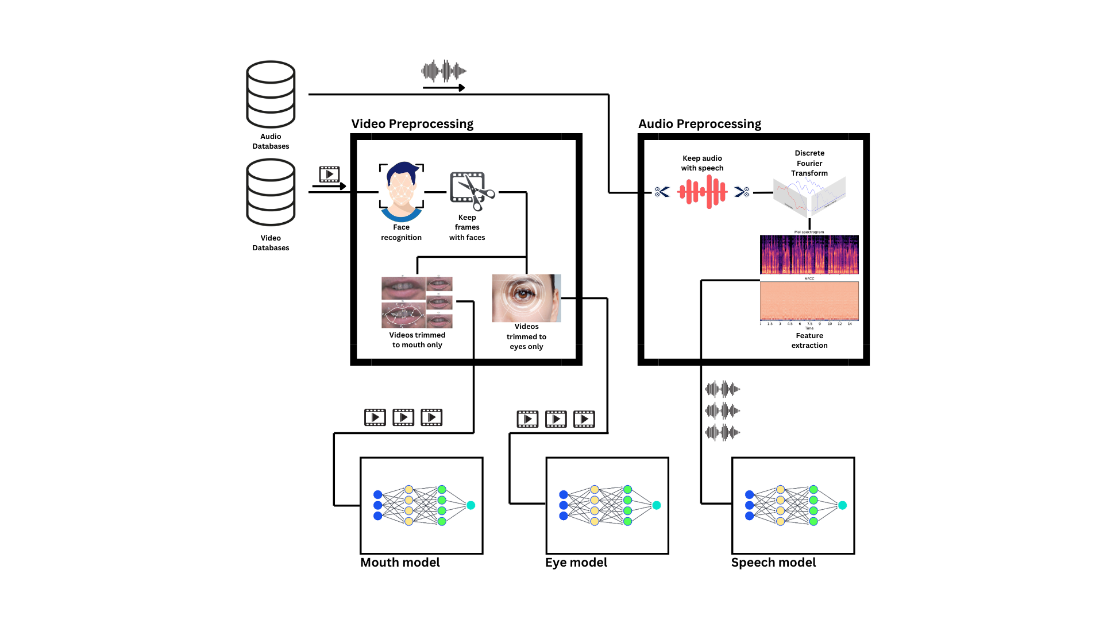
Model Architecture
Training Phase

Slide 11
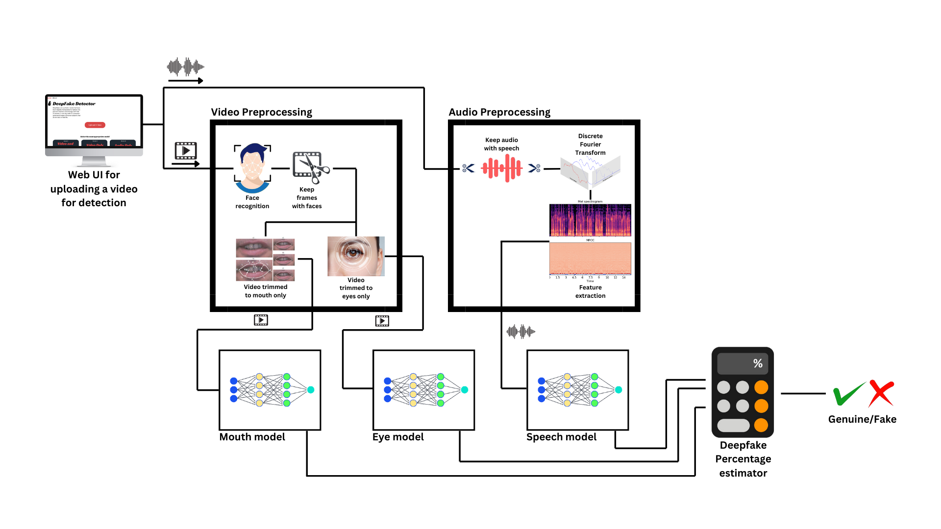
Model Architecture
Usage Diagram

Slide 12
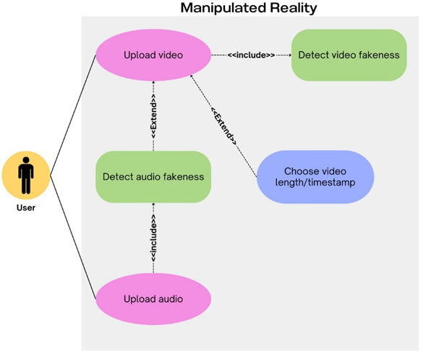
Use case Diagram

Slide 13
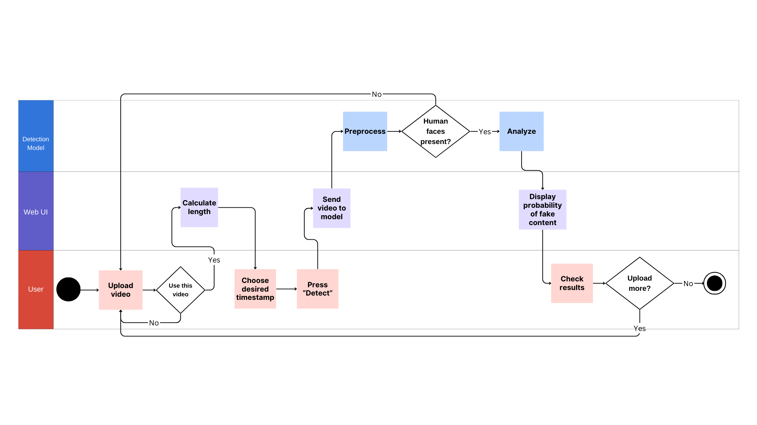
Activity Diagram

Slide 14
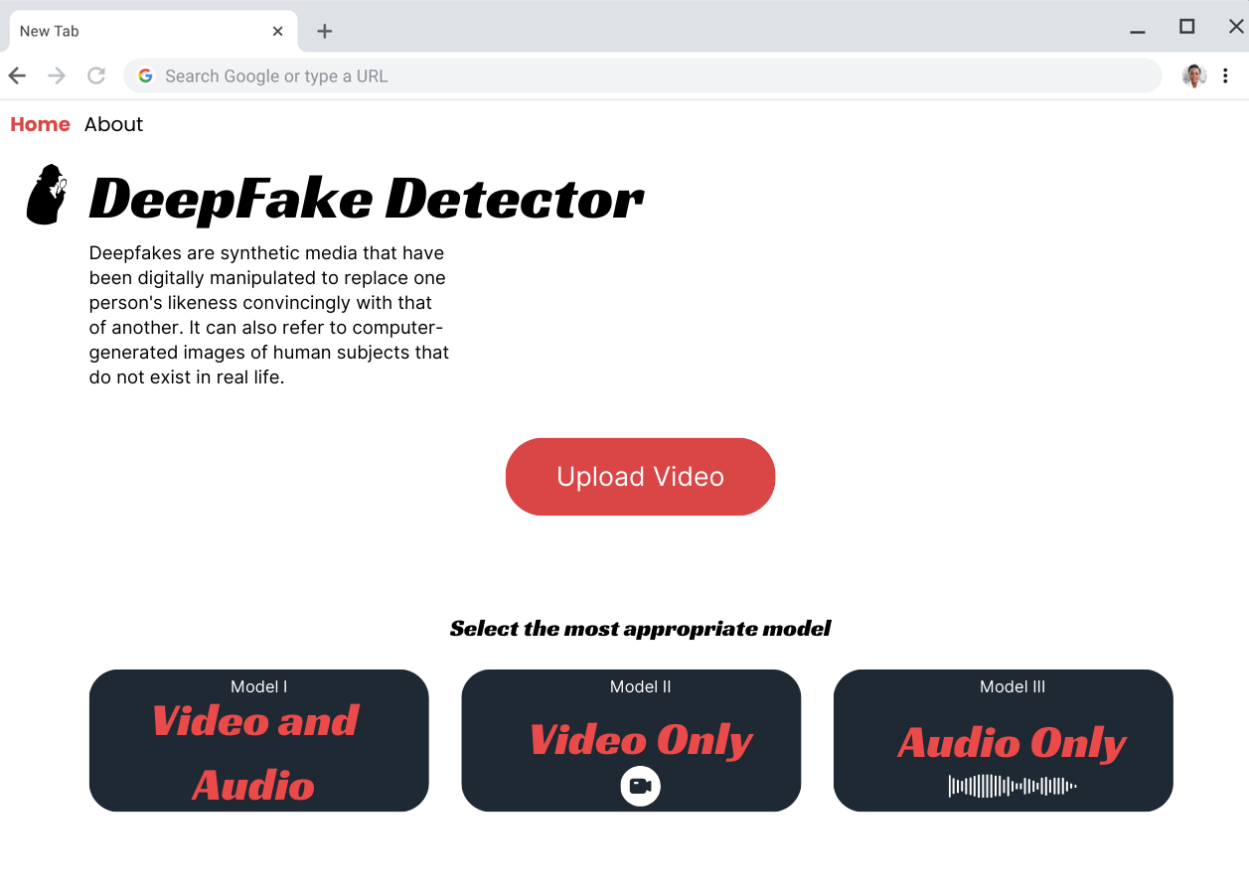
User Interface
Landing Page, initial page serves as the entry point for user interaction.

Slide 15
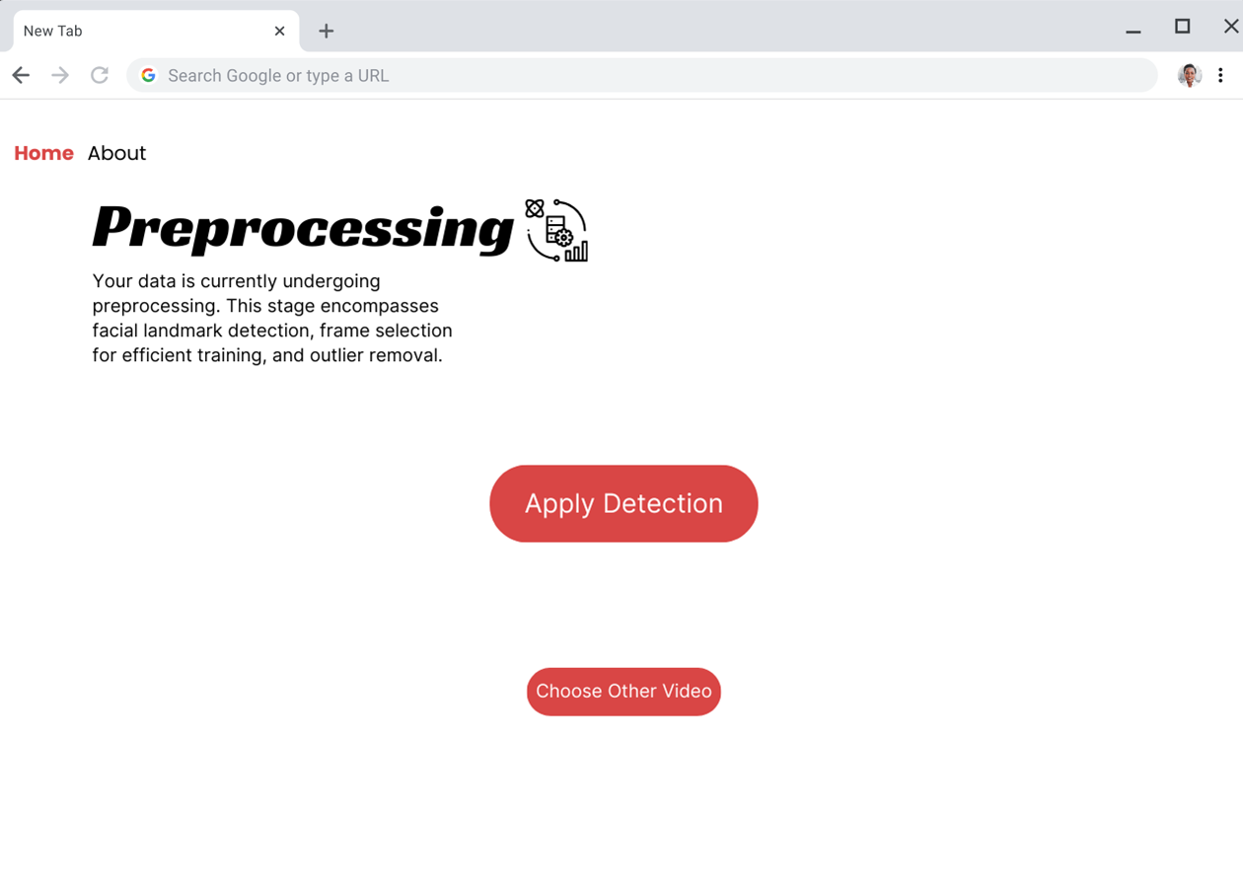
User Interface
Preprocessing Stage, Following video upload, an automated preprocessing step is initiated.

Slide 16
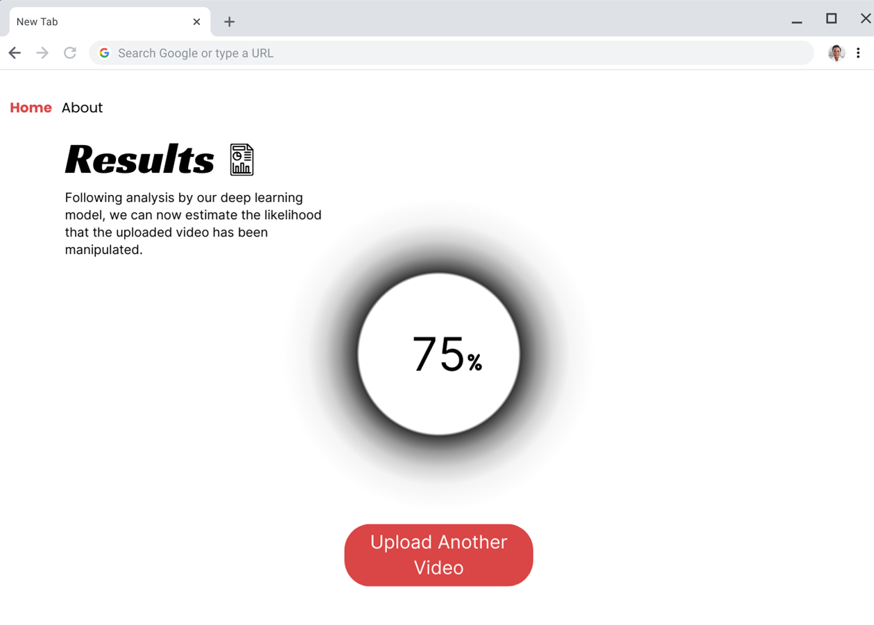
User Interface
Result Display, Upon completion of analysis, the UI presents the user with the outcome.

Slide 17
Testing
Test cases
Upload various file formats
Upload videos without faces
Upload audio without speech
Accurately determine a low quality deepfake as fake
Validation
Test UI on 5 fellow students
Test model performance on fake videos created by us
Test model performance on fake audio speech created by us

Slide 18

Questions

Slide 19


